Slide 1

Compiler Design (CSX-403) Dr Aruna Malik
Physical Layer
Data & Signal, Transmission Impairments, and Channel Capacity

Slide 2
UNIT 1
Introduction
Language Processors
Analysis and Synthesis Model
Phases of Compiler
Compiler Construction tools

Slide 3
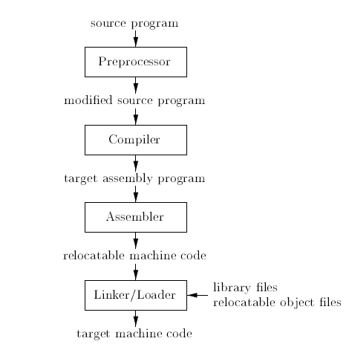
INTRODUCTION OF LANGUAGE PROCESSING SYSTEM

Slide 4
Analysis and Synthesis model
There are two parts to compilation: analysis and synthesis.
The analysis part breaks up the source program into constituent pieces and creates an intermediate
representation of the source program.
The synthesis part constructs the desired target program from the intermediate representation.

Slide 5
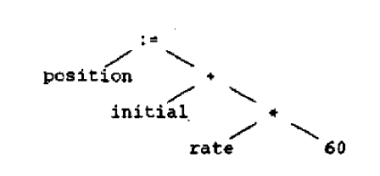
Analysis and Synthesis model

Slide 6
Other Tools that Use the Analysis-Synthesis Model
Editors (syntax highlighting)
Pretty printers (e.g. Doxygen)
Static checkers (e.g. Lint and Splint)
Interpreters
Text formatters (e.g. TeX and LaTeX)
Silicon compilers (e.g. VHDL)
Query interpreters/compilers (Databases)

Slide 7
ANALYSIS OF THE SOURCE PROGRAM
Linear Analysis
Hierarchical Analysis
Semantic Analysis

Slide 8
The Grouping of Phases
Compiler front and back ends:
Front end: analysis (machine independent)
Back end: synthesis (machine dependent)
Compiler passes:
A collection of phases is done only once (single pass) or multiple times (multi pass)
Single pass: usually requires everything to be defined before being used in source program
Multi pass: compiler may have to keep entire program representation in memory

Slide 9
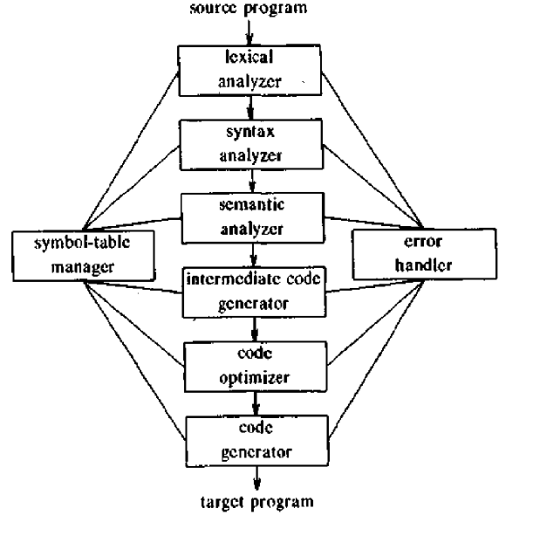
Phases of Compiler

Slide 10
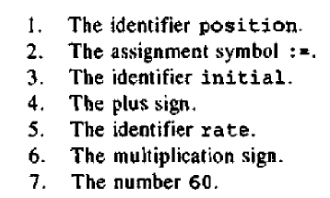
Lexical Analysis

Slide 11
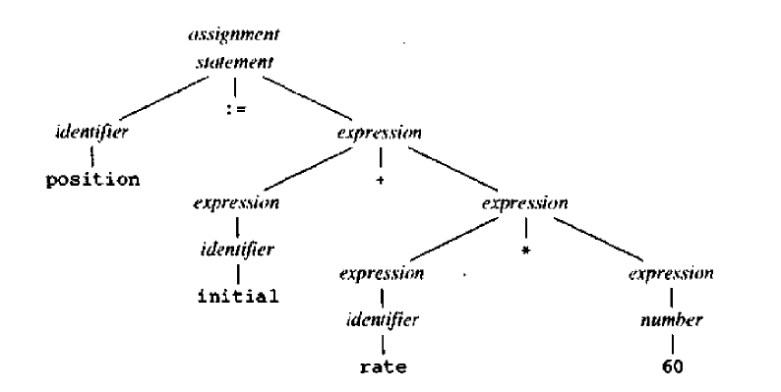

Syntax Analysis

Slide 12
Semantic Analysis
The semantic analyzer uses the syntax tree and the information in the symbol table to check the source program for semantic consistency with the language definition.
It also gathers type information and saves it in either the syntax tree or the symbol table, for subsequent use during intermediate-code generation.
An important part of semantic analysis is type checking, where the compiler checks that each operator has matching operands.

Slide 13
Symbol Table Management
An essential function of a compiler is to record the identifiers used in the
Symbol Table is a data structure containing a record for each identifier, with fields for the attributes of the identifier. The data structure allows us to find the record for each identifier quickly and to store or retrieve data from that record quickly.

Slide 14
Error Detection and Reporting
Each phase can encounter errors. However, after detecting an error, a phase must somehow deal with that error, so that compilation can proceed, allowing further errors in the source program to be detected.

Slide 15
Intermediate Code Generation
After syntax and semantic analysis of the source program, many compilers generate an explicit low-level or machine-like intermediate representation, which we can think of as a program for an abstract machine.
This intermediate representation should have two important properties: it should be easy to produce and it should be easy to translate into the target machine.

Slide 16
Code Optimization
The machine-independent code-optimization phase attempts to improve the intermediate code so that better target code will result.
Usually better means faster, but other objectives may be desired, such as shorter code, or target code that consumes less power.

Slide 17
Code Generation
The code generator takes as input an intermediate representation of the source program and maps it into the target language.
If the target language is machine code, registers or memory locations are selected for each of the variables used by the program.
Then, the intermediate instructions are translated into sequences of machine instructions that perform the same task.
A crucial aspect of code generation is the judicious assignment of registers to hold variables.

Slide 18
COM PILER-CONSTRUCTION TOOLS
1. Parser generators that automatically produce syntax analyzers from a grammatical description of a programming language.
2. Scanner generators that produce lexical analyzers from a regular-expression description of the tokens of a language.
3. Syntax-directed translation engines that produce collections of routines for walking a parse tree and generating intermediate code.
4. Code-generator generators that produce a code generator from a collection of rules for translating each operation of the intermediate language into the machine language for a target machine.
5. Dataflow analysis engines that facilitate the gathering of information about how values are transmitted from one part of a program to each other part.

Slide 19
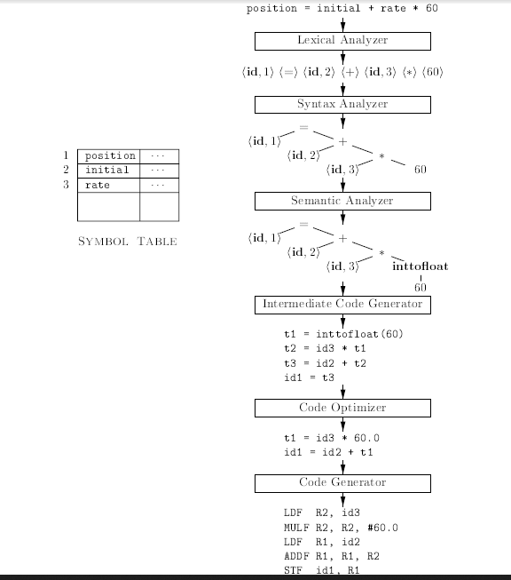

Slide 20
The analysis phase of a compiler breaks up a source program into constituent pieces and produces an internal representation for it, called intermediate code.
The synthesis phase translates the intermediate code into the target program.
Analysis is organized around the “syntax” of the language to be compiled.
The syntax of a programming language describes the proper form of its pro-grams, while the semantics of the language defines what its programs mean; that is, what each program does when it executes.
For specifying syntax, context-free grammars or BNF (for Backus-Naur Form) is used.
For specifying semantics, informal descriptions are used.

Slide 21
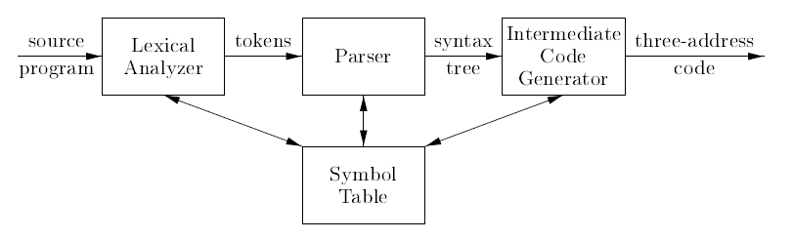
Model of a Compiler Front End

Slide 22
SYNTAX DEFINITION
A context-free grammar has four components:
1. A set of terminal symbols, sometimes referred to as Tokens. The terminals are the elementary symbols of the language defined by the grammar.
2. A set of nonterminals, sometimes called syntactic variables.
3. A set of productions, where each production consists of a nonterminal, called the head or left side of the production, an arrow, and a sequence of terminals and/or nonterminals, called the body or right side of the produc-tion.
4. A designation of one of the nonterminals as the start symbol.

Slide 23
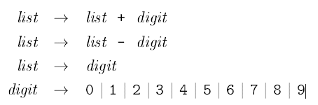

The right sides of the three productions with nonterrninal list on the left
side can equivalently be grouped:
the terminals of the grammar are the symbols or tokens
+ - 0 1 2 3 4 5 6 7 8 9
The nonterminals are the italicized names list and digit, with list being the start symbol because its productions are given first.

Slide 24
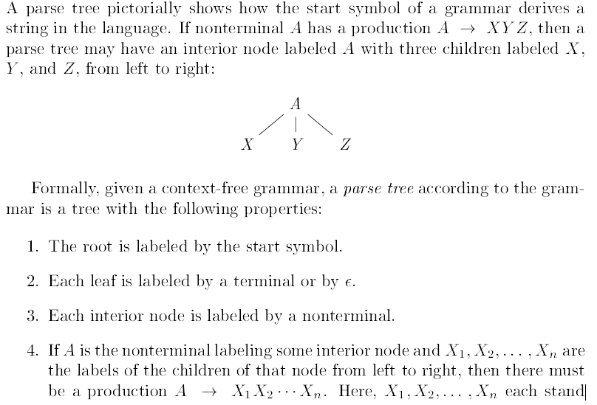
Parse Tree

Slide 25

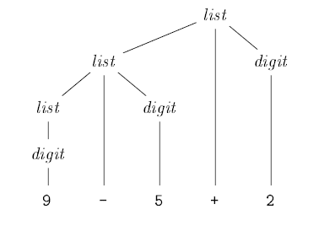


Slide 26
The process of finding a parse tree for a given string of terminals is called parsing that string.
A grammar can have more than one parse tree generating a given string of terminals. Such a grammar is said to be ambiguous.
To show that a grammar is ambiguous, all we need to do is find a terminal string that is the yield of more than one parse tree.

Slide 27
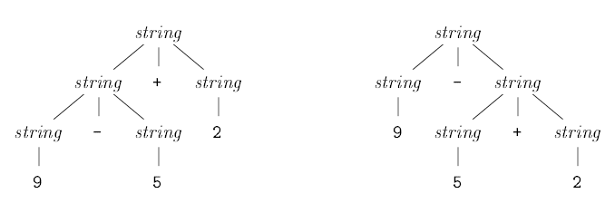
Two parse trees for 9-5+2

Slide 28

By convention, 9+5+2 is equivalent to (9+5)+2 and 9-5-2 is equivalent to (9-5)-2.
When an operand like 5 has operators to its left and right, conventions are needed for deciding which operator applies to that operand.
We say that the operator + associates to the left, because an operand with plus signs on both sides of it belongs to the operator to its left.
In most programming languages the four arithmetic operators, addition, subtraction, multiplication, and division are left-associative.
Some common operators such as exponentiation are right-associative.

Slide 29
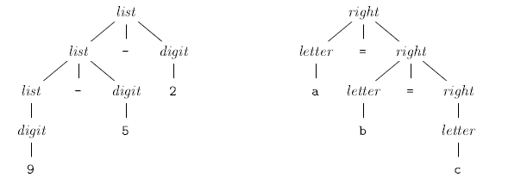
Parse trees for left- and right-associative grammars

Slide 30
Precedence of Operators
Consider the expression 9+5*2. There are two possible interpretations of this expression: (9+5)*2 or 9+(5*2).
* has higher precedence than + if * takes its operands before + does.
In ordinary arithmetic, multiplication and division have higher precedence than addition and subtraction.
Therefore, 5 is taken by * in both 9+5*2 and 9*5+2; i.e., the expressions are equivalent to 9+(5*2) and (9*5)+2, respectively.

Slide 31
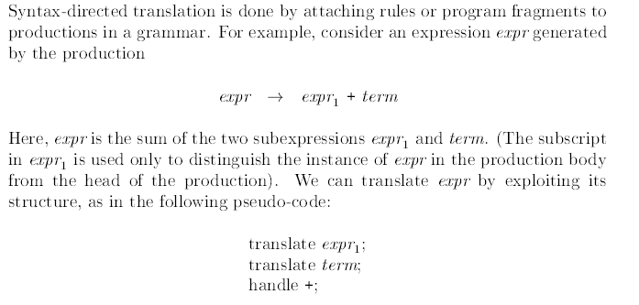
Syntax-Directed Translation

Slide 32
Postfix Notation
The postfix notation for an expression E can be defined inductively as follows:
1. If E is a variable or constant, then the postfix notation for E is E itself.
2. If E is an expression of the form E1 op E2, where op is any binary operator, then the postfix notation for E is E₁' E₂' op, where E₁' and E₂' are the postfix notations for E₁ and E₂, respectively
3. If E is a parenthesized expression of the form (E1), then the postfix notation for E is the same as the postfix notation for E1.

Slide 33
Consider the postfix expression 952+-3*.
Scanning from the left, we First encounter the plus sign. Looking to its left we find operands 5 and 2. Their sum, 7, replaces 52+, and we have the string 97-3*. Now, the leftmost operator is the minus sign, and its operands are 9 and 7. Replacing these by
the result of the subtraction leaves 23*. Last, the multiplication sign applies to 2 and 3, giving the result 6.

Slide 34
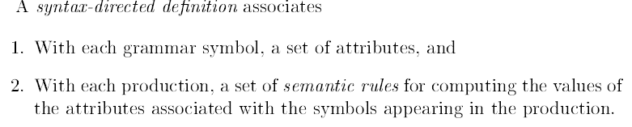


Synthesized Attributes

Slide 35
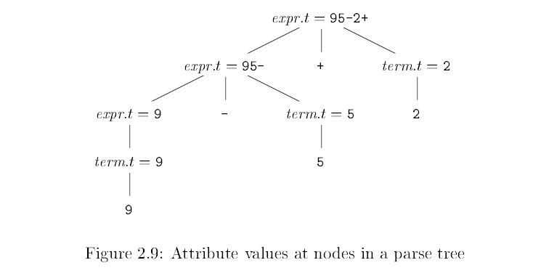

Slide 36
Parsing
Parsing is the process of determining if a string of tokens can be generated by a grammar.
Most parsing methods fall into one of two classes, called the top-down and bottom-up methods.
In top-down parsers, construction starts at the root and proceeds towards the leaves, while in bottom-up parsers, construction starts at the leaves and proceeds towards the root.
The popularity of top-down parsers is due to the fact that efficient parsers can be constructed more easily by hand using top-down methods.
Bottom-up parsing, however, can handle a larger class of grammars and translation schemes, so software tools for generating parsers directly from grammars often use bottom-up methods.

Slide 37
Top Down Parsing
The top-down construction of a parse tree is done by starting with the root, labeled with the starting nonterminal stmt, and repeatedly performing the following two steps.
At node N, labeled with nonterminal A, select one of the productions for A and construct children at N for the symbols in the production body.
Find the next node at which a subtree is to be constructed.
For some grammars, the above steps can be implemented during a single left-to-right scan of the input string.
The current terminal being scanned in the input is frequently referred to as the look ahead symbol.
Initially, the lookahead symbol is the first, i.e., leftmost, terminal of the input string.

Slide 38
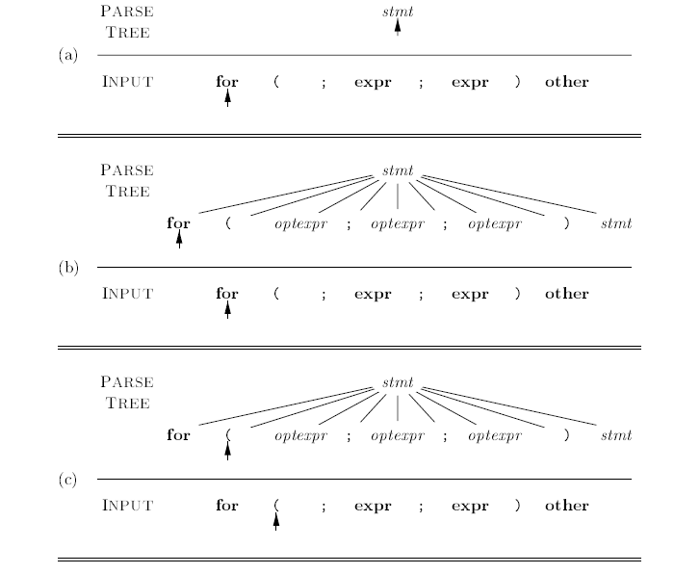

Top Down Parsing while scanning the Input from Left to Right

Slide 39
Predictive Parsing
Recursive-descent parsing is a top-down method of syntax analysis in which a set of recursive procedures is used to process the input.
One procedure is associated with each nonterminal of a grammar.
A simple form of recursive-descent parsing, called predictive parsing, in which the lookahead symbol unambiguously determines the flow of control through the procedure body for each nonterminal.

